Slide 1
ECEG-5193: Algorithm Analysis and Design
Algorithm Design Techniques
Divide and Conquer

Slide 2
Divide and Conquer
Algorithm design paradigm that follows the following steps
Breaks up a problem into independent sub problems.
Solve each problem.
Combine results of the sub problems to form a solution to the original problem.
Notes:
Precedes succeeds

Slide 3
Divide-and-Conquer Algorithms
A divide-and-conquer algorithm is one that works as follows:
(Divide)
Split the input apart into multiple smaller pieces, then recursively invoke the algorithm on those pieces.
(Conquer)
Combine those solutions back together to form the overall answer.
Can be analyzed using recurrence relations.

Slide 4
Finding the Maximum Value
3 | 1 | 4 | 10 | 5 | 9 | 12 | 6 | 7 | 8 | 11 | 2 | 13 | 14 | 0 | 11
11

Slide 5
Finding the Maximum Value
3
10
9
12
8
11
14
11
14
3 | 1 | 4 | 10 | 5 | 9 | 12 | 6 | 7 | 8 | 11 | 2 | 13 | 14 | 0 | 11
11

Slide 6
Finding the Maximum Value
3 | 10 | 9 | 12 | 8 | 11 | 14 | 11
3 | 1 | 4 | 10 | 5 | 9 | 12 | 6 | 7 | 8 | 11 | 2 | 13 | 14 | 0 | 11
11

Slide 7
Finding the Maximum Value
10
12
11
14
3 | 10 | 9 | 12 | 8 | 11 | 14 | 11
3 | 1 | 4 | 10 | 5 | 9 | 12 | 6 | 7 | 8 | 11 | 2 | 13 | 14 | 0 | 11
11

Slide 8
Finding the Maximum Value
10 | 12 | 11 | 14
3 | 10 | 9 | 12 | 8 | 11 | 14 | 11
3 | 1 | 4 | 10 | 5 | 9 | 12 | 6 | 7 | 8 | 11 | 2 | 13 | 14 | 0 | 11
11

Slide 9
Finding the Maximum Value
12
14
10 | 12 | 11 | 14
3 | 10 | 9 | 12 | 8 | 11 | 14 | 11
3 | 1 | 4 | 10 | 5 | 9 | 12 | 6 | 7 | 8 | 11 | 2 | 13 | 14 | 0 | 11
11

Slide 10
Finding the Maximum Value
12
14
10 | 12 | 11 | 14
3 | 10 | 9 | 12 | 8 | 11 | 14 | 11
3 | 1 | 4 | 10 | 5 | 9 | 12 | 6 | 7 | 8 | 11 | 2 | 13 | 14 | 0 | 11
11

Slide 11
Finding the Maximum Value
14
12
14
10 | 12 | 11 | 14
3 | 10 | 9 | 12 | 8 | 11 | 14 | 11
3 | 1 | 4 | 10 | 5 | 9 | 12 | 6 | 7 | 8 | 11 | 2 | 13 | 14 | 0 | 11
11

Slide 12
Finding the Maximum Value
14
12
14
10 | 12 | 11 | 14
3 | 10 | 9 | 12 | 8 | 11 | 14 | 11
3 | 1 | 4 | 10 | 5 | 9 | 12 | 6 | 7 | 8 | 11 | 2 | 13 | 14 | 0 | 11
11

Slide 13
Finding the Maximum Value
14
12
14
10 | 12 | 11 | 14
3 | 10 | 9 | 12 | 8 | 11 | 14 | 11
3 | 1 | 4 | 10 | 5 | 9 | 12 | 6 | 7 | 8 | 11 | 2 | 13 | 14 | 0 | 11
11
T(1) = Θ(1)
T(n) = T(⌈n / 2⌉) + Θ(n)

Slide 14
Finding the Maximum Value
14
12
14
10 | 12 | 11 | 14
3 | 10 | 9 | 12 | 8 | 11 | 14 | 11
3 | 1 | 4 | 10 | 5 | 9 | 12 | 6 | 7 | 8 | 11 | 2 | 13 | 14 | 0 | 11
11
T(1) ≤ c
T(n) ≤ T(⌈n / 2⌉) + cn

Slide 15
Finding the Maximum Value
14
12
14
10 | 12 | 11 | 14
3 | 10 | 9 | 12 | 8 | 11 | 14 | 11
3 | 1 | 4 | 10 | 5 | 9 | 12 | 6 | 7 | 8 | 11 | 2 | 13 | 14 | 0 | 11
11
T(1) ≤ c
T(n) ≤ T(n / 2) + cn

Slide 16
Finding the Maximum Value
14
12
14
10 | 12 | 11 | 14
3 | 10 | 9 | 12 | 8 | 11 | 14 | 11
3 | 1 | 4 | 10 | 5 | 9 | 12 | 6 | 7 | 8 | 11 | 2 | 13 | 14 | 0 | 11
11
cn + cn / 2 + … + c
T(1) ≤ c
T(n) ≤ T(n / 2) + cn

Slide 17
Finding the Maximum Value
14
12
14
10 | 12 | 11 | 14
3 | 10 | 9 | 12 | 8 | 11 | 14 | 11
3 | 1 | 4 | 10 | 5 | 9 | 12 | 6 | 7 | 8 | 11 | 2 | 13 | 14 | 0 | 11
11
cn + cn / 2 + … + c
= cn (1 + ½ + … + ¹/_{n})
T(1) ≤ c
T(n) ≤ T(n / 2) + cn

Slide 18
Finding the Maximum Value
14
12
14
10 | 12 | 11 | 14
3 | 10 | 9 | 12 | 8 | 11 | 14 | 11
3 | 1 | 4 | 10 | 5 | 9 | 12 | 6 | 7 | 8 | 11 | 2 | 13 | 14 | 0 | 11
11
cn + cn / 2 + … + c
= cn (1 + ½ + … + ¹/_{n})
≤ cn (1 + ½ + ¼ + …)
T(1) ≤ c
T(n) ≤ T(n / 2) + cn

Slide 19
Finding the Maximum Value
14
12
14
10 | 12 | 11 | 14
3 | 10 | 9 | 12 | 8 | 11 | 14 | 11
3 | 1 | 4 | 10 | 5 | 9 | 12 | 6 | 7 | 8 | 11 | 2 | 13 | 14 | 0 | 11
11
cn + cn / 2 + … + c
= cn (1 + ½ + … + ¹/_{n})
≤ cn (1 + ½ + ¼ + …)
= 2cn
T(1) ≤ c
T(n) ≤ T(n / 2) + cn

Slide 20
Finding the Maximum Value
14
12
14
10 | 12 | 11 | 14
3 | 10 | 9 | 12 | 8 | 11 | 14 | 11
3 | 1 | 4 | 10 | 5 | 9 | 12 | 6 | 7 | 8 | 11 | 2 | 13 | 14 | 0 | 11
11
cn + cn / 2 + … + c
= cn (1 + ½ + … + ¹/_{n})
≤ cn (1 + ½ + ¼ + …)
= 2cn = O(n)
T(1) ≤ c
T(n) ≤ T(n / 2) + cn

Slide 21
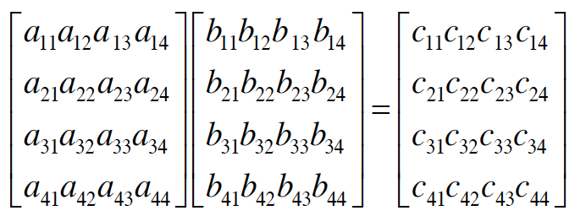
MATRIX MULTIPLICATION

Slide 22
Multiplying Matrices
N³ MULTIPLICATIONS, N³-N² ADDITIONS

Slide 23
Simple Matrix Multiply
for i = 1 to n
for j = I to n
C[i,j] = 0
for k = 1 to n
C[i,j] = C[i,j] + A[i,k] * B[k,j]
N³ MULTIPLICATIONS, N³-N² ADDITIONS

Slide 24
Multiplying Matrices

Slide 25
Multiplying Matrices
A₁₁
A₁₂
B₁₁
B₁₂
A₂₁
A₂₂
B₂₁
B₂₂
A₁₁B₁₁+A₁₂B₂₁
A₁₁B₁₂+A₁₂B₂₂
A₂₁B₁₁+A₂₂B₂₁
A₂₁B₁₂+A₂₂B₂₂

Slide 26
MATRIX MULTIPLICATION
Divide and conquer?
• Break into 4 pieces

Slide 27
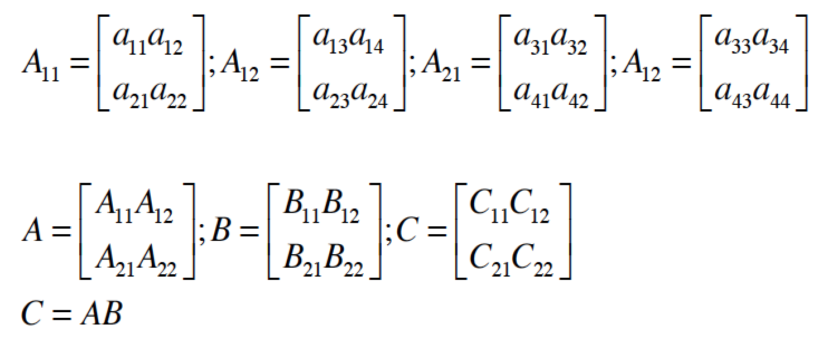
MATRIX MULTIPLICATION

Slide 28
MATRIX MULTIPLICATION
How many recursive calls to matrix multiply?
8 total multiplications = 8 recursive calls
Cost of combining recursions?
4 matrix additions, each matrix size n²/4

Slide 29
Multiplying Matrices
A₁₁
A₁₂
B₁₁
B₁₂
Counting arithmetic operations: T(n) = 8T(n/2) + 4(n/2)² = 8T(n/2) + n²
A₂₁
A₂₂
B₂₁
B₂₂
A₁₁B₁₁+A₁₂B₂₁
A₁₁B₁₂+A₁₂B₂₂
=
A₂₁B₁₁+A₂₂B₂₁
A₂₁B₁₂+A₂₂B₂₂

Slide 30
MATRIX MULTIPLICATION
Divide: constant time
Conquer: 8 matrix multiplications of size
Combine: 4 matrix additions, each has size
Total:
Cost?

Slide 31
Multiplying Matrices
1 if n = 1
T(n) =
8T(n/2) + n² if n > 1
By Master Recurrence, if T(n) = aT(n/b)+cn^{k} & a > b^{k} then T(n) =

Slide 32
Strassen’s method for matrix multiplication
A divide and conquer approach
Divide each nxn matrix into four matrices of size (n/2)x(n/2):
Computing all of requires 8 multiplications and 4 additions.
Therefore, the total running time is
Using the Master Theorem, this solves to . Still cubic!
Can we do better with a straightforward divide and conquer approach?
Notes:
[] לפני שנציג את השיטה ננסה לראות מה קורה כשממנים להחיל את עיקרון "הפרד ומשול" באופן נאיבי:
[] כדי לכפול זוג מטריצות A וְ – B בגודל n, נחלק כל אחת מן המטריצות לארבע מטריצות בגודל n/2.
[] נבחין כי במטריצת התוצאה, כל רבע ממנה מחושב על ידי מכפלת זוג רבעים של המטריצות המקוריות.
[] חישוב של כל רבע במטריצת התוצאה דורש שתי פעולות מכפלה של מטריצות קטנות יותר ופעולת חיבור.
[] בסה"כ נדרשות 8 פעולות כפל וארבע פעולות חיבור. לכן, זמן הריצה יכול להיות מחושב לפי נוסחת נסיגה.
[] על ידי שימוש במשפט המאסטר, אפשר למצוא כי מהנוסחה נובע שזמן הריצה נשאר באותו סדר גודל
כפי שהיה אם היינו מבצעים את המכפלה באופן נאיבי.
[] האם ניתן לחשוב על שיטה טובה יותר המבוססת על עיקרון "הפרד ומשול"?
32

Slide 33
Strassen’s method for matrix multiplication
Strassen’s algorithm
Define seven matrices of size (n/2)x(n/2) :
The four (n/2)x(n/2) matrices can be defined in terms of M₁,…,M₇:
33
Notes:
[] המהות של השיטה של Srassen: הפחתה במכפלה אחת של מטריצות על חשבון מספר פעולות חיבור וחיסור נוספות.
[] מכפלת המטריצות הקטנות יותר הנובעות מחלוקה המטריצות המקוריות לארבעה רבעים, מחושבת באופן רקורסיבי.
[] בסה"כ בכל שלב יש לנו 7 פעולות מכפלה והרבה פעולות חיבור וחיבור שדורשות זמן בסדר גודל של O(n²).
הערה: השיטה של Strassen כוללת פעולות חיבור, כפל וחיסור של מטריצות. פעולות לוגיות המתאימות לחיבור ולכפל הן
OR וְ-AND, אבל חסרה פעולה לוגית מתאימה עבור חיסור. לכן, כדי להתאים את השיטה לכפל מטריצות בוליאניות, תוצאה
חיובית של מכפלת שורה בעמודה נמיר לערך 1 ותוצאה שהיא 0 נשאיר כמו שהיא. לדוגמא:
[1 0 1] * [1 1 1] = 1*1 + 0*1 + 1*1 = 2 >> 1
33

Slide 34
Strassen’s method for matrix multiplication
Strassen’s algorithm
Running time? Each matrix Mi requires additions
and subtractions but only one multiplication:
which solves to
O(n^{2.807}) | Volker Strassen: Strassen’s method , First sub-cubic time algorithm | 1969
34
34
Notes:
[] הפעלה רקורסיבית של השיטה של Strassen בכל מכפלה המתבקשת עבור M_{i} תיתן את זמן הריצה המתואר.
[] השיטה של Strassen הוצעה על ידי Volker Strassen בשנת 1969, בערך באותו הזמן בו הוצעה השיטה
של ארבעת הרוסים.
http://www.cs.berkeley.edu/~virgi/matrixmult.pdf
http://en.wikipedia.org/wiki/Matrix_multiplication
http://en.wikipedia.org/wiki/Coppersmith%E2%80%93Winograd_algorithm
34

Slide 35
Strassen’s method for matrix multiplication
Improvements
O(n^{2.796}) | V. Y. Pan. Strassen’s algorithm is not optimal. | 1978
O(n^{2.7799}) | D. Bini et al. O(n^{2.7799}) complexity for nxn approximate matrix multiplication. | 1979
O(n^{2.522}) | A. Schönhage. Partial and total matrix multiplication. | 1981
First to break the 2.5 barrier:
O(n^{2.496}) | CopperSmith and Winograd On the asymptotic complexity of matrix multiplication. | 1981
O(n^{2.479}) | Volker Strassen | 1986
O(n^{2.376}) | CopperSmith and Winograd Matrix multiplication via arithmetic progressions. | 1989
O(n^{2.3727}) | Virginia Vassilevska Williams: Breaking the Coppersmith-Winograd barrier | 2011
35
35
Notes:
[] קופרסמית' ווינוגרד לא נשארו חייבים והראו לשטראסן כי טובים השניים מן האחד.
[] במשך למעלה מעשרים שנים השיא לא נשבר, עד אשר לאחרונה חוקרת בשם וירג'יניה
וסילבסקה וויליאמס, מאוניברסיטת ברקלי (קליפורניה) מצאה את החסם הטוב ביותר עד כה.
35

Slide 36
Best choices for matrix multiplication
Using the exact formulas for time complexity, for square matrices, crossover points
have been found:
For n<7, the naïve algorithm for matrix multiplication is preferred. As an example, a 6x6 matrix requires 482 steps for the method of 4- Russians, but 468 steps for the naïve multiplication.
For 6<n<513, the method of 4-Russians is most efficient.
For 512<n, Strassen’s approach costs the least number of steps.
36
Notes:
[] תוך שימוש בנוסחאות המדויקות לסיבוכיות זמן הריצה של השיטות השונות, ניתן להבחין בערכים
עבורם עדיפה שיטה אחת על פני האחרת.
[] לדוגמא, עבור n<7...
[] נסייג ונאמר כי החישובים כאן נלקחו ממאמר שהציג וריאציה של השיטה של ארבעת הרוסים והיא
אינה זהה לשיטה כפי שתיאר לי פרופ' דיניץ.
[] בנוסף, בשנת 70, חבר של פרופ' דיניץ מסר לו כי לפי חישובים שהוא ערך השיטה של Strassen
למכפלת מטריצות עדיפה על השיטה הנאיבית רק החל ממטריצות שממדיהן בסדר גודל של 10^20.
[] נראה, אם כן, שהנתונים מיוחסים לגישה של Strassen באופן כולל ולאו דווקא לשיטה המקורית.
36

Slide 37
Closest Pair of Points
Closest pair. Given n points in the plane, find a pair with smallest Euclidean distance between them.
Fundamental geometric primitive.
Graphics, computer vision, geographic information systems, molecular modeling, air traffic control.
Special case of nearest neighbor, Euclidean MST, Voronoi.
Brute force. Check all pairs of points p and q with Θ(n²) comparisons.
1-D version. O(n log n) easy if points are on a line.
Assumption. No two points have same x coordinate.
fast closest pair inspired fast algorithms for these problems
to make presentation cleaner
Notes:
Foundation of then-fledgling field of computational geometry.
"Shamos and Hoey (1970's) wanted to work out basic computational primitives in computational geometry. Surprisingly challenging to find an efficient algorithm. Shamos and Hoey asked whether it was possible to do better than quadratic. The algorithm we present is essentially their solution."

Slide 38
Closest-Pair Problem by Divide-and-Conquer
Step 1 Divide the points given into two subsets P_{l} and P_{r} by a vertical line x = m so that half the points lie to the left or on the line and half the points lie to the right or on the line.

Slide 39
Closest Pair by Divide-and-Conquer (cont.)
Step 2 Find recursively the closest pairs for the left and right subsets.
Step 3 Set d = min{d_{l}, d_{r}}
We can limit our attention to the points in the symmetric vertical strip S of width 2d as possible closest pair. (The points are stored and processed in increasing order of their y coordinates.)
Step 4 Scan the points in the vertical strip S from the lowest up. For every point p(x,y) in the strip, inspect points in in the strip that may be closer to p than d. There can be no more than 5 such points following p on the strip list!
Notes:
Unfortunately, d is not necessarily the smallest distance between all pairs of points in S1 and
S2 because a closer pair of points can lie on the opposite sides separating the line. When we
combine the two sets, we must examine such points. (Illustrate this on the diagram)

Slide 40
Efficiency of the Closest-Pair Algorithm
Running time of the algorithm is described by
T(n) = 2T(n/2) + M(n), where M(n) ∈ O(n)
By the Master Theorem (with a = 2, b = 2, d = 1)
T(n) ∈ O(n log n)

Slide 43
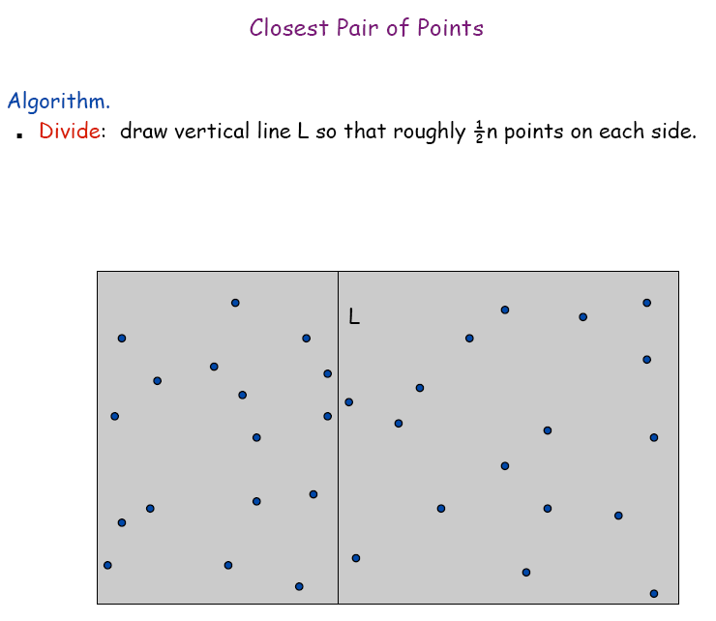

Slide 44
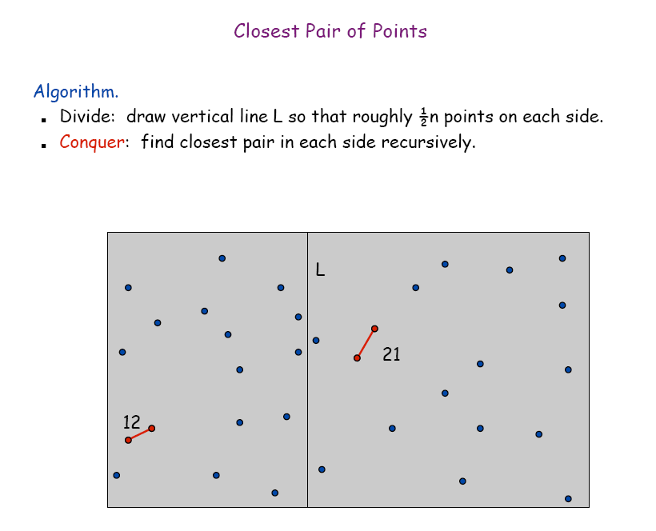

Slide 47
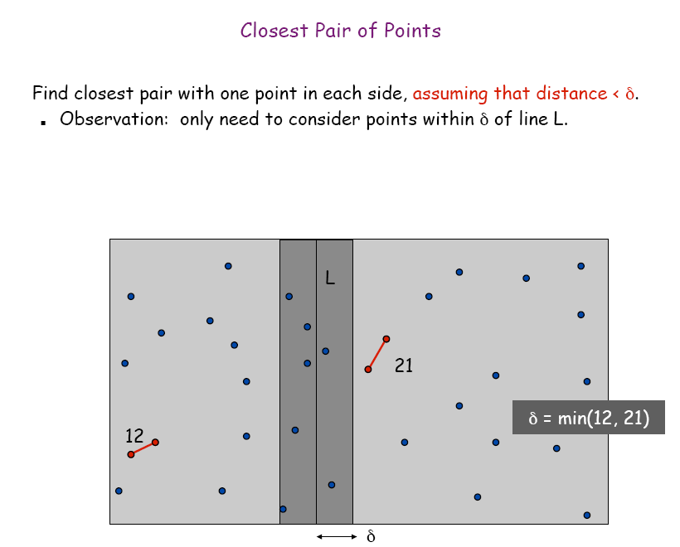

Slide 48
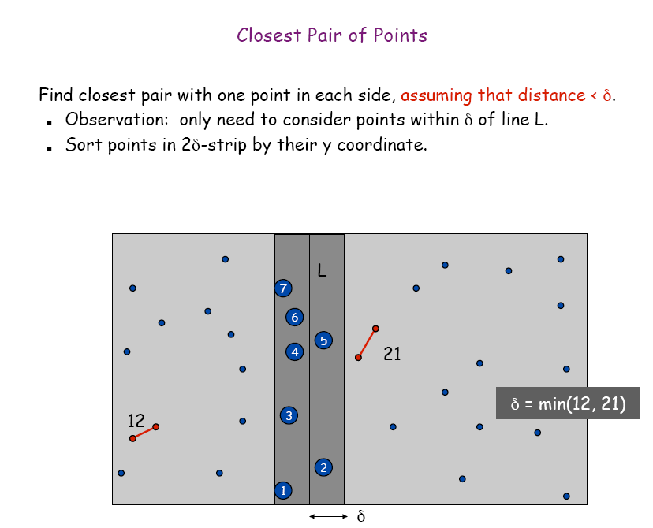

Slide 49
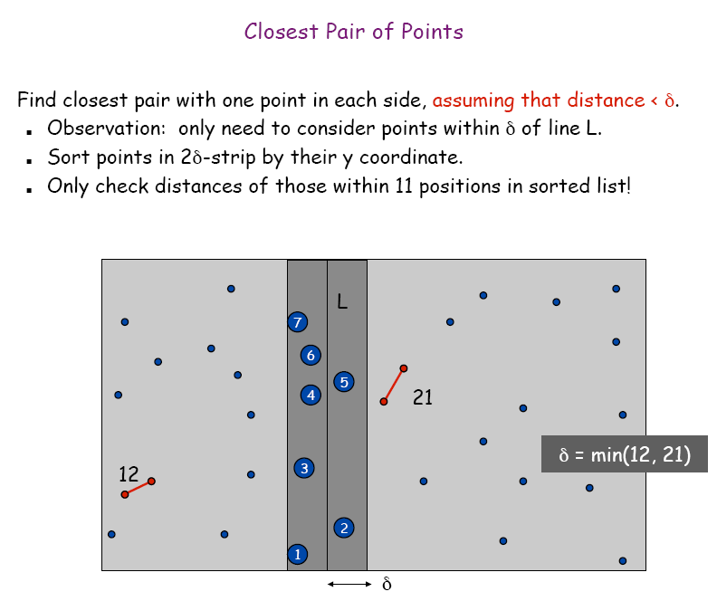

Slide 50
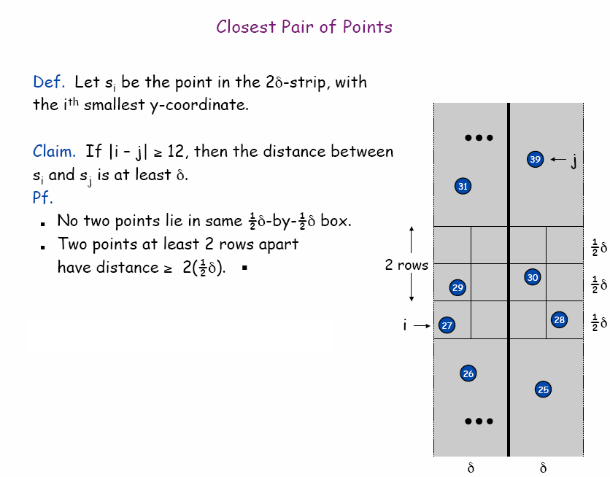

Slide 51
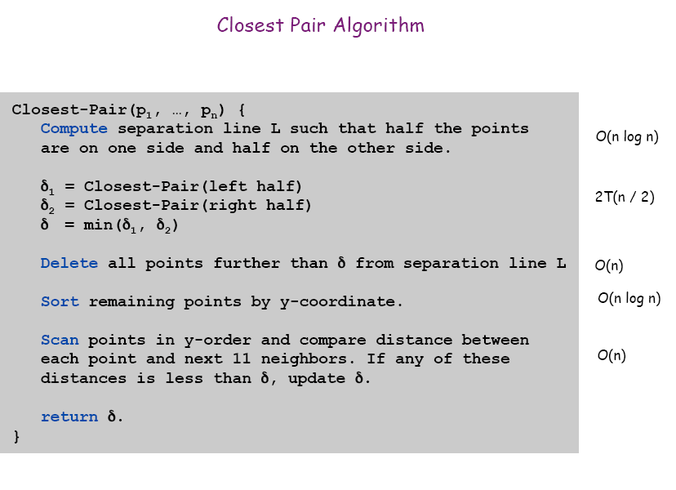
Can be done in O(n) time if we sort all the points first.

Slide 52
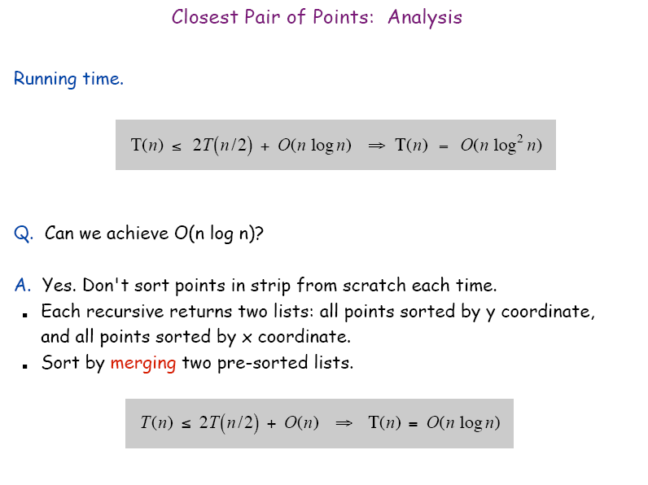

Slide 53
Closest-Pair(p₁, …, p_{n}) {
xg: array sorted based on x in increasing order
yg: array sorted based on y in increasing order
Compute separation line L such that half the points are on one side and half on the other side.
Create sorted xg1 (left half), xg2(right half), yg1(left half) and yg2 (right half). O(n)
δ1 = Closest-Pair(xg1,yg1) (δ2 = Closest-Pair(xg2,yg2)
( δ= min((δ1, δ2))
Merge:
Delete all points further than δ from separation line L (O(n) time)
Create array new-yg for remaining points sorted by y-coordinatein (O(n) time).
for (i=0; i<= size of new-yg; i++)
for (j=1; j<=11; j++) (the nested loop takes O(n) time)
if (d(new-yg[i], new-yg[i+j]<δ) then δ=d(new-yg[i], new-yg[j];
return δ.
}

Slide 54
The closest Pair (see the program )
Combine (The last step)
y
80
(47,75)
(33,70)
70
(44,65)
(34,60)
60
(12,60)
(49,55)
(5,50)
(40,50)
(69,55)
50
(36,40)
(46,40)
(74,43)
40
(17,40)
(39,30)
(41,30)
30
(50,25)
(38,20)
20
(42,19)
(30,13)
(65,14)
10
(37,8)
(43,9)
(0,5)
(10,4)
(78,2)
x
(31,0)
(48,0)
(60,1)
(0,0)
10
20
30
40
50
60
70
80

Slide 55
The closest Pair (see the program )
1st:blue. 2nd:green,
3rd: orange
Combine (The last step)
y
*
*
80
*
(47,75)
(33,70)
70
(44,65)
(34,60)
60
(12,60)
(49,55)
(5,50)
(40,50)
(69,55)
50
(36,40)
(46,40)
(74,43)
40
(17,40)
(39,30)
(41,30)
30
(50,25)
(38,20)
20
(42,19)
(30,13)
(65,14)
10
(37,8)
(43,9)
(0,5)
(10,4)
(78,2)
x
(31,0)
(48,0)
(60,1)
(0,0)
10
20
30
40
50
60
70
80

Slide 56
Example 1
Input: points p₁, p₂,…,p₈ in a plane.
p₁=(1,4), p₂=(2,5), p₃=(4,2), p₄=(7,2), p₅=(10,3), p₆=(13,4),p₇=(14,4), p₈=(15,3)
₆
p₆
p₇
p₂
₄
p₁
p₅
p₈
₂
p₃
p₄
₀
₂
₄
₆
₈
₁₀
₁₂
₁₄
₁₆

Slide 57
Find a line L₁ such that 4 points are on one side and the other 4 points are on the other side.
₆
L₁
p₆
p₇
p₂
₄
p₁
p₅
p₈
₂
p₃
p₄
₀
₂
₄
₆
₈
₁₀
₁₂
₁₄
₁₆

Slide 58
Consider the left four points p₁,p₂,p₃,p₄. Find a line L₂ such that 2 points are on one side and the other 2 points are on the other side. δ₁ =Closest-pair (Region 1) = dist(p₁,p₂) = . δ₂ =Closest- pair (Region 2) = dist(p₃,p₄) = 3 δ=min(δ₁ ,δ₂)=
₆
L₂
Reg 2
L₁
p₆
p₇
p₁
₄
p₂
₃
p₈
p₅
₂
p₃
p₄
Reg 1
₀
₂
₄
₆
₈
₁₀
₁₂
₁₄
₁₆

Slide 59
Delete the points in Region 1 and 2 further than δ= from L₂
Compare the distance dist(p₁,p₃) with δ.
Here dist(p₁,p₃) = > δ, δ is not updated.
Closest-pair (Region 1 and 2) = dist(p₁,p₂) = .
₆
L₂
Reg 2
L₁
p₆
p₇
p₁
₄
p₅
p₈
₂
p₃
p₄
Reg 1
₀
₂
₄
₆
₈
₁₀
₁₂
₁₄
₁₆

Slide 60
For the four points p₅,p₆,p₇,p₈, we use a line L₃ to divide them and use similar method to find
δ₁ =Closest-pair (Region 3) = dist(p₅,p₆) =
δ₂ =Closest- pair (Region 4) = dist(p₇,p₈) =
δ= min(δ₁ ,δ₂)=
₆
L₂
Reg 2
L₁
Reg 3
L₃
Reg 4
p₆
p₇
p₁
₄
p₂
p₅
p₈
₂
p₃
p₄
Reg 1
₀
₂
₄
₆
₈
₁₀
₁₂
₁₄
₁₆

Slide 61
Delete the points in Region 1 and 2 further than δ= from L₃
Compare the distance dist(p₆,p₈) with δ.
Here dist(p₆,p₈) = >δ, δ is not updated.
Compare the distance dist(p₆,p₇) with δ.
Here dist(p₆,p₇) = 1 < δ, δ is updated.
Closest-pair (Region 3 and 4) = dist(p₆,p₇) = 1.
₆
L₂
Reg 2
L₁
Reg 3
L₃
Reg 4
p₆
₁
p₇
p₁
₄
p₂
p₅
p₈
₂
p₃
p₄
Reg 1
₀
₂
₄
₆
₈
₁₀
₁₂
₁₄
₁₆

Slide 62
Consider Region 1 , 2 and Region 3, 4 as two large regions.
δ₁ =Closest-pair (Region 1 and 2) = dist(p₁,p₂) =
δ₂ =Closest- pair (Region 3 and 4) = dist(p₆,p₇) = 1
δ= min(δ₁ ,δ₂)= 1
₆
L₂
Reg 2
L₁
Reg 3
L₃
Reg 4
p₆
₁
p₇
p₁
₄
p₂
p₅
p₈
₂
p₃
p₄
Reg 1
₀
₂
₄
₆
₈
₁₀
₁₂
₁₄
₁₆

Slide 63
Delete the points in Region 1, 2, 3 and 4 further than δ= 1 from L₁
Here only one point p4 is left, δ is not updated.
Closest-pair (Region 1, 2, 3 and 4) = dist(p₆,p₇) = 1.
₆
L₂
Reg 2
L₁
Reg 3
L₃
Reg 4
p₆
₁
p₇
p₁
₄
p₂
p₅
p₈
₂
Reg 1
p₃
p₄
₀
₂
₄
₆
₈
₁₀
₁₂
₁₄
₁₆

Slide 64
5-2 The Closest Pair Problem
Closest Pair ?
Given a set S of n points, find a pair of points which are closest together
1-D version:
2-D version:
Y
X
Time Complexity：O(nlogn)
X

Slide 65
Closest Pair Algorithm
Input: A set S of n planar points.
Output: The distance between two closest points.
Step 1: Sort points in S according to their y-values.
Step 2: If S contains only one point, return infinity as its distance.
Step 3: Find a median line L perpendicular to the X-axis to divide S into S_{L} and S_{R}, with equal sizes.
Step 4: Recursively apply Steps 2 and 3 to solve the closest pair problems of S_{L} and S_{R}. Let d_{L}(d_{R}) denote the distance between the closest pair in S_{L} (S_{R}). Let d = min(d_{L}, d_{R}).

Slide 66
Closest Pair Algorithm Illustration - 1
Step 1
Step 2
Step 3
If only one point
Time Complexity：O(n)
Y
Y
L
S_{L}
S_{R}
d = ∞
X
X

Slide 67
Closet Pair Algorithm Illustration - 2
Step 4
Time Complexity：2T(n/2)
Y
L
L
S_{L}
S_{R}
X

Slide 68
Closet Pair Algorithm Illustration - 3
Step 5
Y
L
S_{L}
S_{R}
d_{L}
d_{R}
X
L-d
L+d
d=min(d_{L},d_{R})

Slide 69
Closet Pair Algorithm Illustration - 4
Y
P
2d
d
X

Slide 70
Closest Pair Time complexity
Time complexity:
Step 1: O(nlogn)
Step 2~5: T(n) = 2T(n/2)+S(n)+M(n)
Total time-complexity = O(nlogn)+T(n) = O(nlogn)+O(nlogn) = O(nlogn)

Slide 71
Closest pair of points
Question: How to handle the case, where two points can have the same x-coordinate?

Slide 72
Quickhull Algorithm
Convex hull: smallest convex set that includes given points
Assume points are sorted by x-coordinate values
Identify extreme points P₁ and P₂ (leftmost and rightmost)
Compute upper hull recursively:
find point P_{max} that is farthest away from line P₁P₂
compute the upper hull of the points to the left of line P₁P_{max}
compute the upper hull of the points to the left of line P_{max}P₂
Compute lower hull in a similar manner
P_{max}
P₂
P₁

Slide 73
Efficiency of Quickhull Algorithm
Finding point farthest away from line P₁P₂ can be done in linear time
Time efficiency:
worst case: Θ(n²) (as quicksort)
average case: Θ(n) (under reasonable assumptions about distribution of points given)
If points are not initially sorted by x-coordinate value, this can be accomplished in O(n log n) time
Several O(n log n) algorithms for convex hull are known

Slide 74
5-3 The Convex Hull Problem
Convex polygon?
Concave polygon:
Convex polygon :

Slide 75
5-3 The Convex Hull Problem (Cont.)
Convex Hull ?
The Convex hull of a set of planar points is defined as the smallest convex polygon containing all of the points.

Slide 76
Convex Hull Algorithm
Input : A set S of planar points
Output : A convex hull for S
Step 1: If S contains no more than five points, use exhaustive searching to find the convex hull and return.
Step 2: Find a median line perpendicular to the X-axis which divides S into S_{L} and S_{R}, with equal sizes.
Step 3: Recursively construct convex hulls for S_{L} and S_{R}, denoted as Hull(S_{L}) and Hull(S_{R}), respectively.
Step 4: Apply the merging procedure to merge Hull(S_{L}) and Hull(S_{R}) together to form a convex hull.

Slide 77
Use Divide-and-Conquer to Solve
L
Y
S_{L}
S_{R}
Use Graham scan
X

Slide 78
Graham Scan Algorithm
Step 1: Select an interior point as the origin.
Step 2: Each other point forms a polar angle, and all points sorted by polar angles
Step 3: Examines the points cause reflexive angles
Step 4: The remaining points are convex hull vertices

Slide 79
The Graham scan (Illustration)
Y
P₂
P₁
P
P₀
P₃
P₅
P₄
X

Slide 80
Eliminates points (Illustration)
Y
P₀,P₁,P₂ (x₀,y₀) (x₁,y₁) (x₂,y₂)
P₄
P₃
P₂
P₅
If det < 0 than
If det > 0 than
If det = 0 than
P₁
P₀
X

Slide 81
Use Divide-and-Conquer to Solve
L
Y
π/2
S_{L}
S_{R}
j
d
i
e
c
k
p
f
h
g
a
b
3π/2
X

Slide 82
Use Divide-and-Conquer to Solve
L
Time Complexity：
T(n) = 2T(n/2) + O(n)
= O(nlogn)
Y
S_{L}
S_{R}
j
d
i
e
c
k
f
h
g
a
b
X

Slide 83
Order Statistics
●
Given a collection of data, the kth order statistic is the kth smallest value in the data set.
For the purposes of this course, we'll use
zero-indexing, so the smallest element would be given by the 0th order statistic.
To give a robust definition: the kth order statistic is the element that would appear at position k if the data were sorted.
●
●
1 | 6 | 1 | 8 | 0 | 3 | 3 | 9

Slide 84
The Selection Problem
●
The selection problem is the following: Given a data set S (typically represented as an array) and a number k, return the kth order statistic of that set.
Has elements of searching and sorting: Want to search for the kth-smallest element, but this is defined relative to a sorted ordering.
●
32 | 17 | 41 | 18 | 52 | 98 | 24 | 65
●
For today, we'll assume all values are distinct.

Slide 85
An Initial Solution
Any ideas how to solve this? Here is one simple solution:
●
●
Sort the array.
Return the element at the kth position.
●
●
●
Unless we know something special about the array, this will run in time O(n log n).
Can we do better?
●

Slide 86
A Useful Subroutine: Partition
●
Given an input array, a partition algorithm chooses some element p (called the pivot), then rearranges the array so that
All elements less than or equal to p are before p. All elements greater p are after p.
p is in the position it would occupy if the array were sorted.
●
●
●
The algorithm then returns the index of p.
We'll talk about how to choose which element should be the pivot later; right now, assume the algorithm chooses one arbitrarily.
●
●

Slide 87
Partitioning an Array
32 | 17 | 41 | 18 | 52 | 98 | 24 | 65

Slide 88
Partitioning an Array
32 | 17 | 41 | 18 | 52 | 98 | 24 | 65

Slide 89
Partitioning an Array
32 | 17 | 41 | 18 | 52 | 98 | 24 | 65
18 | 17 | 24 | 32 | 41 | 65 | 52 | 98

Slide 90
Partitioning an Array
32 | 17 | 41 | 18 | 52 | 98 | 24 | 65

Slide 91
Partitioning an Array
32 | 17 | 41 | 18 | 52 | 98 | 24 | 65
41 | 65 | 18 | 32 | 52 | 17 | 24 | 98

Slide 92
Partitioning and Selection
●
There is a close connection between partitioning and the selection problem.
18 | 32 | 17 | 24 | 41 | 98 | 52 | 65
●
Let k be the desired index and p be the pivot index after a partition step. Then:
●
If p = k, return A[k].

Slide 93
Partitioning and Selection
●
There is a close connection between partitioning and the selection problem.
18 | 32 | 17 | 24 | 41 | 98 | 52 | 65
●
Let k be the desired index and p be the pivot index after a partition step. Then:
●
If p = k, return A[k].

Slide 94
Partitioning and Selection
●
There is a close connection between partitioning and the selection problem.
24 | 41 | 17 | 18 | 32 | 52 | 65 | 98
●
Let k be the desired index and p be the pivot index after a partition step. Then:
●
If p = k, return A[k].

Slide 95
Partitioning and Selection
●
There is a close connection between partitioning and the selection problem.
24 | 41 | 17 | 18 | 32 | 52 | 65 | 98
●
Let k be the desired index and p be the pivot index after a partition step. Then:
●
If p = k, return A[k].

Slide 96
Partitioning and Selection
●
There is a close connection between partitioning and the selection problem.
24 | 41 | 17 | 18 | 32 | 52 | 65 | 98
●
Let k be the desired index and p be the pivot index after a partition step. Then:
If p = k, return A[k].
If p > k, recursively select element k from the elements before the pivot.
●
●

Slide 97
Partitioning and Selection
●
There is a close connection between partitioning and the selection problem.
18 | 32 | 17 | 24 | 41 | 98 | 52 | 65
●
Let k be the desired index and p be the pivot index after a partition step. Then:
If p = k, return A[k].
If p > k, recursively select element k from the elements before the pivot.
●
●

Slide 98
Partitioning and Selection
●
There is a close connection between partitioning and the selection problem.
18 | 32 | 17 | 24 | 41 | 98 | 52 | 65
●
Let k be the desired index and p be the pivot index after a partition step. Then:
If p = k, return A[k].
If p > k, recursively select element k from the elements before the pivot.
●
●

Slide 99
Partitioning and Selection
●
There is a close connection between partitioning and the selection problem.
17 | 18 | 65 | 98 | 41 | 32 | 52 | 24
●
Let k be the desired index and p be the pivot index after a partition step. Then:
If p = k, return A[k].
If p > k, recursively select element k from the elements before the pivot.
●
●

Slide 100
Partitioning and Selection
●
There is a close connection between partitioning and the selection problem.
17 | 18 | 65 | 98 | 41 | 32 | 52 | 24
●
Let k be the desired index and p be the pivot index after a partition step. Then:
If p = k, return A[k].
If p > k, recursively select element k from the elements before the pivot.
●
●

Slide 101
Partitioning and Selection
●
There is a close connection between partitioning and the selection problem.
17 | 18 | 65 | 98 | 41 | 32 | 52 | 24
●
Let k be the desired index and p be the pivot index after a partition step. Then:
If p = k, return A[k].
If p > k, recursively select element k from the elements before the pivot.
If p < k, recursively select element (k – p – 1) from the elements after the pivot.
●
●
●

Slide 102
Procedure select(array A, int k):
let p = partition(A)
if p = k:
return A[p]
else if p > k:
return select(A[0, p–1], k)
else if p < k:
Return select(A[p+1 … length(A)–1], k-p-1)

Slide 103
Some Facts
●
The partitioning algorithm on an array of length n can be made to run in time Θ(n).
Check the Problem Set Advice handout for an outline of an algorithm to do this.
Partitioning algorithms give no guarantee about which element is selected as the pivot.
Each recursive call does Θ(n) work, then makes a recursive call on a smaller array.
●
●
●

Slide 104
Analyzing the Runtime
●
The runtime of our algorithm depends on our choice of pivot.
In the best-case, if we pick a pivot that ends up at position k, the runtime is Θ(n).
In the worst case, we pick always pick pivot that is the minimum or maximum value in the array. The runtime is given by this recurrence:
●
●
T(1) = Θ(1)
T(n) = T(n – 1) + Θ(n)

Slide 105
Analyzing the Runtime
Our runtime is given by this recurrence:
T(1) = Θ(1)
T(n) =T(n – 1) + Θ(n)
Can we apply the Master Theorem?
First call does roughly n work, second does roughly n – 1, third does roughly n – 2, etc.
Total work is n + (n – 1) + (n – 2) + … + 1.
This is Θ(n²).

Slide 106
Finding a Good Pivot
Recall: We recurse on one of the two pieces of the array if we don't immediately find the element we want.
A good pivot should split the array so that each piece is some constant fraction of the size of the array.
(Those sizes don't have to be the same.)

Slide 107
Finding a Good Pivot
Recall: We recurse on one of the two pieces of the array if we don't immediately find the element we want.
A good pivot should split the array so that each piece is some constant fraction of the size of the array.
(Those sizes don't have to be the same.)
1 / 2 | 1 / 2

Slide 108

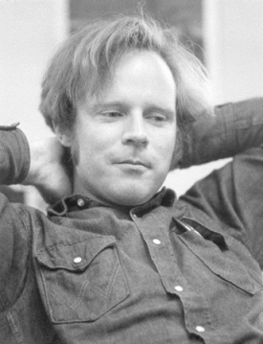



BFPRT Algorithm
A very clever “choose” algorithm . . .
Split into n/5 sets of size 5
M be the set of medians of these sets
Return x = the median of M
M. Blum
R. Floyd
V. Pratt
R. Rivest
R. Tarjan

Slide 109
BFPRT runtime
Split into n/5 sets of size 5
Let M be the set of medians of these sets
Choose x to be the median of M
Construct S₁ , S₂ and S₃ as above
Recursive call in S₁ or S₃
To show: |S₁| < 3n/4, |S₃| < 3n/4
n/5 + 3n/4 = 0.95n ⇒ O(n), worst case

Slide 110
Median of Medians
small large
x = median of medians
NB: conceptual; algorithm finds median(s), but does not sort

Slide 111
Median of Medians
Points ≥ x, ∴ NOT in S₁
≈ 3n/10 of them
small large
Bottom Line: recursive call on S₁ or S₃ includes only about 70% of points
x = median of medians
Points ≤ x, ∴ NOT in S₃
≈ 3n/10 of them
NB: conceptual; algorithm finds median(s), but does not sort

Slide 112
The Median of Medians
Arrange the numbers in groups of five
………………..
2
54
44
4
25
………………..
5
32
18
39
………………..
………………..
5
47
………………..
9
87
21
26
………………..
19
9
13
16
56
………………..
………………..
24
10
2
19
71
………………..
………………..

Slide 113
Find median of N/5 groups
………………..
2
5
2
4
25
………………..
5
13
16
39
………………..
………………..
9
………………..
9
10
21
18
47
………………..
19
54
32
19
56
………………..
………………..
24
87
44
26
71
………………..
………………..
Median of each group

Slide 114
Find the Median of each group
………………..
2
5
2
4
25
………………..
3.n/10
………………..
………………..
5
9
13
16
39
47
………………..
9
10
21
18
………………..
19
54
32
19
56
………………..
………………..
24
87
44
26
71
………………..
………………..
Find m ,the median of medians

Slide 115
Find the sets L and R
Compare each n-1 elements with the median m and find two sets L and R such that every element in L is smaller than M and every element in R is greater than m.
m
L
R
3n/10<L<7n/10
3n/10<R<7n/10

Slide 116
Description of the Algorithm step
If n is small, for example n<6, just sort and return the k the smallest number.( Bound time- 7)
If n>5, then partition the numbers into groups of 5.(Bound time n/5)
Sort the numbers within each group. Select the middle elements (the medians). (Bound time- 7n/5)
Call your "Selection" routine recursively to find the median of n/5 medians and call it m. (Bound time-T_{n/5})

Slide 117
Contd….
Compare all n-1 elements with the median of medians m and determine the sets L and R, where L contains all elements <m, and R contains all elements >m. Clearly, the rank of m is r=|L|+1 (|L| is the size or cardinality of L). (Bound time- n)
If k=r, then return m
If k<r, then return k ^{th} smallest of the set L .(Bound time T_{7n/10})
If k>r, then return k-r ^{th} smallest of the set R.

Slide 118
Recursive formula
T (n)=O (n) + T (n/5) +T (7n/10)
We will solve this equation in order to get the complexity.
We assume that T (n)< C*n
T (n)= a*n + T (n/5) + T (7n/10)
C*n>=T(n/5) +T(7n/10) + a*n
C>= C*n/5+ C*7*n/5 + a*n
C>= 9*C/10 +a
C/10>= a
C>=10*a
There is such a constant that exists….so T (n) = O (n)

Slide 119
Why group of 5 why not some other term??
If we divide elements into groups of 3 then we will have
T (n) = O (n) + T (n/3) + T (2n/3) so T (n) > O (n)…..
If we divide elements into groups of more than 5, the value of constant 5 will be more, so grouping elements in to 5 is the optimal situation.

Slide 120
The New Recurrence
The median-of-medians algorithm does the following:
Split the input into blocks of size 5 in time Θ(n).
Compute the median of each block non-recursively. Takes time Θ(n), since there are about n / 5 blocks.
Recursively invoke the algorithm on this list of n / 5 blocks to get a pivot.
Partition using that pivot in time Θ(n).
Make up to one recursive call on an input of size at most 7n / 10.
T(1) = Θ(1)
T(n) ≤ T(⌊n / 5⌋) + T(⌊7n / 10⌋) + Θ(n)

Slide 121
The New Recurrence
The median-of-medians algorithm does the following:
Split the input into blocks of size 5 in time Θ(n).
Compute the median of each block non-recursively. Takes time Θ(n), since there are about n / 5 blocks.
Recursively invoke the algorithm on this list of n / 5 blocks to get a pivot.
Partition using that pivot in time Θ(n).
Make up to one recursive call on an input of size at most 7n / 10.
some errors. We'll address them in a while
T(1) = Θ(1)
T(n) ≤ T(⌊n / 5⌋) + T(⌊7n / 10⌋) + Θ(n)

Slide 122
A Better Analysis
Each of the ⌈⌈n / 5⌉ / 2⌉ – 2 “normal” blocks contributes three elements greater than ★.
If we let X denote the number of elements greater than ★, we get
X ≥ 3(⌈⌈n / 5⌉ / 2⌉ – 2)
≥ 3(n / 10 – 2)
= 3n / 10 – 6
Our recursive call can be on a subarray of size
n – X ≤ n – (3n / 10 – 6)
≤ 7n / 10 + 6

Slide 123
The Real Recurrence Relation
The most accurate recurrence relation for our algorithm is the following:
T(n) ≤ c if n ≤ 100
T(n) ≤ T(⌈n / 5⌉) + T(⌈7n / 10 + 6⌉) + cn otherwise
Let's see if we can prove this is O(n).

Slide 124
T(n) ≤ c if n ≤ 100
T(n) ≤ T(⌈n / 5⌉) + T(⌈7n / 10 + 6⌉) + cn otherwise
Theorem: T(n) = O(n).
We will prove that for some constant k to be chosen later, T(n) ≤ kn for all n ≥ 1; T(n) = O(n) follows. We proceed by induction.
As our base case, if 1 ≤ n ≤ 100, then T(n) ≤ c ≤ kn if we choose k ≥ c.
For the inductive step, assume that for some n ≥ 100, the claim holds for all 1 ≤ n' < n.
Note that if n ≥ 100 that ⌈n / 5⌉ < n and ⌈7n /10 + 6⌉ < n.
Therefore:
T(n) ≤ T(⌈n / 5⌉) + T(⌈7n / 10 + 6⌉) + cn
≤ k⌈n / 5⌉ + k(⌈7n / 10 + 6⌉) + cn
≤ k(n / 5 + 1) + k(7n / 10 + 6 + 1) + cn
= 9kn / 10 + 8k + cn
= kn + (8k + cn – kn / 10)
If (8k + cn – kn /10) ≤ 0, then T(n) ≤ kn.
It's left as an exercise to the reader to check that this is true if we pick k = 50c.
Thus T(n) ≤ kn, completing the induction.
This uses the identity
⌈x⌉ < x + 1

Slide 125
A Note on O(n)
This linear-time selection algorithm does run in time O(n), but there is a huge constant factor hidden here.
Two reasons:
Work done by each call is large; finding the median of each block requires nontrivial work.
Problem size decays slowly across levels; each layer is roughly 10% smaller than its predecessor.
Is there a way to get O(n) behavior without such a huge constant factor?

Slide 126
The New Recurrence
●
Our new recurrence is
T(1) = Θ(1)
T(n) ≤ T(⌊n / 5⌋) + T(⌊7n / 10⌋) + Θ(n)
Can we apply the Master Theorem here?
Is the work increasing, decreasing, or the same across all levels?
What do you expect the recurrence to solve to?
●
●
●

Slide 127
A Problem
●
What is the value of this recurrence when n = 4?
T(1) = Θ(1)
T(n) ≤ T(⌊n / 5⌋) + T(⌊7n / 10⌋) + Θ(n)
● It's undefined!
● Why haven't we seen this before?

Slide 128
A Problem
●
What is the value of this recurrence when n = 4?
T(1) = Θ(1)
T(n) ≤ T(⌊n / 5⌋) + T(⌊7n / 10⌋) + Θ(n)
It's undefined!
Why haven't we seen this before?
●
●

Slide 129
Fixing the Recurrence
For very small values of n, this recurrence will try to evaluate T(0), even though that's not defined.
To fix this, we will use the “fat base case” approach and redefine the recurrence as follows:
●
●
T(n) = Θ(1)
T(n) ≤ T(⌊n / 5⌋) + T(⌊7n / 10⌋) + Θ(n)
if n ≤ 100 otherwise
●
(There are still some small errors we'll correct later.)

Slide 130
Setting up the Recurrence
●
We will show that the following recurrence is O(n):
T(n) = Θ(1)
T(n) ≤ T(⌊n / 5⌋) + T(⌊7n / 10⌋) + Θ(n)
if n ≤ 100 otherwise
●
Making our standard simplifying assumptions about the values hidden in the Θ terms:
T(n) ≤ c
T(n) ≤ T(⌊n / 5⌋) + T(⌊7n / 10⌋) + cn
if n ≤ 100 otherwise

Slide 131
Proving the O(n) Bound
●
We cannot easily use the iteration method because of the floors and ceilings.
The recursion-tree method is unlikely to be helpful because the tree shape is lopsided.
Instead, we will use a technique called the
substitution method.
We will guess that T(n) ≤ kn for some constant
k we will determine later.
We will then use a proof by induction to show that for the right constants, T(n) ≤ kn is true.
●
●
●
●

Slide 132
T(n) ≤ c
T(n) ≤ T(⌊n / 5⌋) + T(⌊7n / 10⌋) + cn
if n ≤ 100 otherwise
Theorem: T(n) = O(n).
Proof: We guess that for all n ≥ 1, T(n) ≤ kn for some k that we will determine later; this means T(n) = O(n).
We proceed by induction. As a base case, if 1 ≤ n ≤ 100, then T(n) ≤ c ≤ kn will be true as long as we pick k ≥ c.
For the inductive step, assume for some n ≥ 100 that the claim holds for all 1 ≤ n' < n. Note that 1 ≤ ⌊n / 5⌋ < n and
1 ≤ ⌊7n / 10⌋ < n. Then
T(n) ≤ T(⌊n / 5⌋) + T(⌊7n / 10⌋) + cn
≤ k⌊n / 5⌋ + k⌊7n / 10⌋ + cn
≤ k(n / 5) + k(7n / 10) + cn
= k(9n / 10) + cn
= n(9k / 10 + c)
If we pick k so 9k / 10 + c ≤ k, then T(n) ≤ kn holds. This is true when c ≤ k / 10, which happens when 10c ≤ k. If we pick k = 10c, then T(n) ≤ kn, completing the induction. ■

Slide 133
The Substitution Method
●
To use the substitution method, proceed as follows:
●
Make a guess of the form of your answer (for example, kn or k₁ n log_{k₂}n.
Proceed by induction to prove the bound holds, noting what constraints arise on the values of your undetermined constants.
If the induction succeeds, you will have values for your undetermined constants and are done.
If the induction fails, you either need to strengthen your assumption about the function or relax your bound.
●
●
●

Slide 134
Nitty-Gritty Details
The recurrence we just analyzed was close to the real recurrence, but is slightly inaccurate due to some rough assumptions about the split size.
Let's try to get a tighter bound on the split size.
●
●

Slide 135
Cases to Consider
<
<
<
<
<
<
<
<
<
<
<
<
>
>
★
<
<
>
>
>
>
>
>
>
>
>
>
>
>
b₁
b₆ b₄ b₉ b₃ b₂ b₇ b₅ b₈

Slide 136
Cases to Consider
<
<
<
<
<
<
<
<
<
<
<
<
>
>
★
<
<
>
>
>
>
>
>
>
>
>
>
b₁
b₆ b₄ b₉ b₃ b₂ b₇ b₅ b₈

Slide 137
Cases to Consider
<
<
<
<
<
<
<
<
<
<
<
<
>
>
★
<
<
>
>
>
>
>
>
>
b₁
b₆ b₄ b₉ b₃ b₂ b₇ b₅

Slide 138
Cases to Consider
>
>
★
<
<
b₁

Slide 139
Cases to Consider
>
★
<
<
b₁

Slide 140
A Better Analysis
●
There are ⌈n / 5⌉ blocks, including the leftover elements.
⌈⌈n / 5⌉ / 2⌉ blocks have elements greater than or equal to the median-of-medians ★.
The block containing ★ and the very last block are special cases. If we ignore them, there are at least ⌈⌈n / 5⌉ / 2⌉ – 2 “normal” blocks greater than the median block.
●
●

Slide 141
A Better Analysis
●
Each of the ⌈⌈n / 5⌉ / 2⌉ – 2 “normal” blocks contributes three elements greater than ★.
If we let X denote the number of elements greater than ★, we get
X ≥ 3(⌈⌈n / 5⌉ / 2⌉ – 2)
≥ 3(n / 10 – 2)
= 3n / 10 – 6
Our recursive call can be on a subarray of size
n – X ≤ n – (3n / 10 – 6)
≤ 7n / 10 + 6
●
●

Slide 142
The Real Recurrence Relation
●
The most accurate recurrence relation for our algorithm is the following:
T(n) ≤ c if n ≤ 100
T(n) ≤ T(⌈n / 5⌉) + T(⌈7n / 10 + 6⌉) + cn otherwise
Let's see if we can prove this is O(n).

Slide 143
T(n) ≤ c if n ≤ 100
T(n) ≤ T(⌈n / 5⌉) + T(⌈7n / 10 + 6⌉) + cn otherwise
Theorem: T(n) = O(n).

Slide 144
T(n) ≤ c if n ≤ 100
T(n) ≤ T(⌈n / 5⌉) + T(⌈7n / 10 + 6⌉) + cn otherwise
Theorem: T(n) = O(n).
Proof: We will prove that for some constant k to be chosen later, T(n) ≤ kn for all n ≥ 1; T(n) = O(n) follows.

Slide 145
T(n) ≤ c if n ≤ 100
T(n) ≤ T(⌈n / 5⌉) + T(⌈7n / 10 + 6⌉) + cn otherwise
Theorem: T(n) = O(n).
Proof: We will prove that for some constant k to be chosen later, T(n) ≤ kn for all n ≥ 1; T(n) = O(n) follows. We proceed by induction.

Slide 146
T(n) ≤ c if n ≤ 100
T(n) ≤ T(⌈n / 5⌉) + T(⌈7n / 10 + 6⌉) + cn otherwise
Theorem: T(n) = O(n).
Proof: We will prove that for some constant k to be chosen later, T(n) ≤ kn for all n ≥ 1; T(n) = O(n) follows. We proceed by induction. As our base case, if 1 ≤ n ≤ 100, then T(n) ≤ c ≤ kn if we choose k ≥ c.

Slide 147
T(n) ≤ c if n ≤ 100
T(n) ≤ T(⌈n / 5⌉) + T(⌈7n / 10 + 6⌉) + cn otherwise
Theorem: T(n) = O(n).
Proof: We will prove that for some constant k to be chosen later, T(n) ≤ kn for all n ≥ 1; T(n) = O(n) follows. We proceed by induction. As our base case, if 1 ≤ n ≤ 100, then T(n) ≤ c ≤ kn if we choose k ≥ c.
For the inductive step, assume that for some n ≥ 100, the claim holds for all 1 ≤ n' < n.

Slide 148
T(n) ≤ c if n ≤ 100
T(n) ≤ T(⌈n / 5⌉) + T(⌈7n / 10 + 6⌉) + cn otherwise
Theorem: T(n) = O(n).
Proof: We will prove that for some constant k to be chosen later, T(n) ≤ kn for all n ≥ 1; T(n) = O(n) follows. We proceed by induction. As our base case, if 1 ≤ n ≤ 100, then T(n) ≤ c ≤ kn if we choose k ≥ c.
For the inductive step, assume that for some n ≥ 100, the claim holds for all 1 ≤ n' < n. Note that if n ≥ 100 that
⌈n / 5⌉ < n and ⌈7n / 10 + 6⌉ < n.

Slide 149
T(n) ≤ c if n ≤ 100
T(n) ≤ T(⌈n / 5⌉) + T(⌈7n / 10 + 6⌉) + cn otherwise
Theorem: T(n) = O(n).
Proof: We will prove that for some constant k to be chosen later, T(n) ≤ kn for all n ≥ 1; T(n) = O(n) follows. We proceed by induction. As our base case, if 1 ≤ n ≤ 100, then T(n) ≤ c ≤ kn if we choose k ≥ c.
For the inductive step, assume that for some n ≥ 100, the claim holds for all 1 ≤ n' < n. Note that if n ≥ 100 that
⌈n / 5⌉ < n and ⌈7n / 10 + 6⌉ < n. Therefore:
T(n) ≤ T(⌈n / 5⌉) + T(⌈7n / 10 + 6⌉) + cn

Slide 150
T(n) ≤ c if n ≤ 100
T(n) ≤ T(⌈n / 5⌉) + T(⌈7n / 10 + 6⌉) + cn otherwise
Theorem: T(n) = O(n).
Proof: We will prove that for some constant k to be chosen later, T(n) ≤ kn for all n ≥ 1; T(n) = O(n) follows. We proceed by induction. As our base case, if 1 ≤ n ≤ 100, then T(n) ≤ c ≤ kn if we choose k ≥ c.
For the inductive step, assume that for some n ≥ 100, the claim holds for all 1 ≤ n' < n. Note that if n ≥ 100 that
⌈n / 5⌉ < n and ⌈7n / 10 + 6⌉ < n. Therefore:
T(n) ≤ T(⌈n / 5⌉) + T(⌈7n / 10 + 6⌉) + cn
≤ k⌈n / 5⌉ + k(⌈7n / 10 + 6⌉) + cn

Slide 151
T(n) ≤ c if n ≤ 100
T(n) ≤ T(⌈n / 5⌉) + T(⌈7n / 10 + 6⌉) + cn otherwise
Theorem: T(n) = O(n).
Proof: We will prove that for some constant k to be chosen later, T(n) ≤ kn for all n ≥ 1; T(n) = O(n) follows. We proceed by induction. As our base case, if 1 ≤ n ≤ 100, then T(n) ≤ c ≤ kn if we choose k ≥ c.
For the inductive step, assume that for some n ≥ 100, the claim holds for all 1 ≤ n' < n. Note that if n ≥ 100 that
⌈n / 5⌉ < n and ⌈7n / 10 + 6⌉ < n. Therefore:
T(n) ≤ T(⌈n / 5⌉) + T(⌈7n / 10 + 6⌉) + cn
≤ k⌈n / 5⌉ + k(⌈7n / 10 + 6⌉) + cn
≤ k(n / 5 + 1) + k(7n / 10 + 6 + 1) + cn

Slide 152
T(n) ≤ c if n ≤ 100
T(n) ≤ T(⌈n / 5⌉) + T(⌈7n / 10 + 6⌉) + cn otherwise
Theorem: T(n) = O(n).
Proof: We will prove that for some constant k to be chosen later, T(n) ≤ kn for all n ≥ 1; T(n) = O(n) follows. We proceed by induction. As our base case, if 1 ≤ n ≤ 100, then T(n) ≤ c ≤ kn if we choose k ≥ c.
For the inductive step, assume that for some n ≥ 100, the claim holds for all 1 ≤ n' < n. Note that if n ≥ 100 that
⌈n / 5⌉ < n and ⌈7n / 10 + 6⌉ < n. Therefore:
T(n) ≤ T(⌈n / 5⌉) + T(⌈7n / 10 + 6⌉) + cn
≤ k⌈n / 5⌉ + k(⌈7n / 10 + 6⌉) + cn
≤ k(n / 5 + 1) + k(7n / 10 + 6 + 1) + cn
This uses the identity
⌈x⌉ < x + 1

Slide 153
T(n) ≤ c if n ≤ 100
T(n) ≤ T(⌈n / 5⌉) + T(⌈7n / 10 + 6⌉) + cn otherwise
Theorem: T(n) = O(n).
Proof: We will prove that for some constant k to be chosen later, T(n) ≤ kn for all n ≥ 1; T(n) = O(n) follows. We proceed by induction. As our base case, if 1 ≤ n ≤ 100, then T(n) ≤ c ≤ kn if we choose k ≥ c.
For the inductive step, assume that for some n ≥ 100, the claim holds for all 1 ≤ n' < n. Note that if n ≥ 100 that
⌈n / 5⌉ < n and ⌈7n / 10 + 6⌉ < n. Therefore:
T(n) ≤ T(⌈n / 5⌉) + T(⌈7n / 10 + 6⌉) + cn
≤ k⌈n / 5⌉ + k(⌈7n / 10 + 6⌉) + cn
≤ k(n / 5 + 1) + k(7n / 10 + 6 + 1) + cn

Slide 154
T(n) ≤ c if n ≤ 100
T(n) ≤ T(⌈n / 5⌉) + T(⌈7n / 10 + 6⌉) + cn otherwise
Theorem: T(n) = O(n).
Proof: We will prove that for some constant k to be chosen later, T(n) ≤ kn for all n ≥ 1; T(n) = O(n) follows. We proceed by induction. As our base case, if 1 ≤ n ≤ 100, then T(n) ≤ c ≤ kn if we choose k ≥ c.
For the inductive step, assume that for some n ≥ 100, the claim holds for all 1 ≤ n' < n. Note that if n ≥ 100 that
⌈n / 5⌉ < n and ⌈7n / 10 + 6⌉ < n. Therefore:
T(n) ≤ T(⌈n / 5⌉) + T(⌈7n / 10 + 6⌉) + cn
≤ k⌈n / 5⌉ + k(⌈7n / 10 + 6⌉) + cn
≤ k(n / 5 + 1) + k(7n / 10 + 6 + 1) + cn
= 9kn / 10 + 8k + cn

Slide 155
T(n) ≤ c if n ≤ 100
T(n) ≤ T(⌈n / 5⌉) + T(⌈7n / 10 + 6⌉) + cn otherwise
Theorem: T(n) = O(n).
Proof: We will prove that for some constant k to be chosen later, T(n) ≤ kn for all n ≥ 1; T(n) = O(n) follows. We proceed by induction. As our base case, if 1 ≤ n ≤ 100, then T(n) ≤ c ≤ kn if we choose k ≥ c.
For the inductive step, assume that for some n ≥ 100, the claim holds for all 1 ≤ n' < n. Note that if n ≥ 100 that
⌈n / 5⌉ < n and ⌈7n / 10 + 6⌉ < n. Therefore:
T(n) ≤ T(⌈n / 5⌉) + T(⌈7n / 10 + 6⌉) + cn
≤ k⌈n / 5⌉ + k(⌈7n / 10 + 6⌉) + cn
≤ k(n / 5 + 1) + k(7n / 10 + 6 + 1) + cn
= 9kn / 10 + 8k + cn
= kn + (8k + cn – kn / 10)

Slide 156
T(n) ≤ c if n ≤ 100
T(n) ≤ T(⌈n / 5⌉) + T(⌈7n / 10 + 6⌉) + cn otherwise
Theorem: T(n) = O(n).
Proof: We will prove that for some constant k to be chosen later, T(n) ≤ kn for all n ≥ 1; T(n) = O(n) follows. We proceed by induction. As our base case, if 1 ≤ n ≤ 100, then T(n) ≤ c ≤ kn if we choose k ≥ c.
For the inductive step, assume that for some n ≥ 100, the claim holds for all 1 ≤ n' < n. Note that if n ≥ 100 that
⌈n / 5⌉ < n and ⌈7n / 10 + 6⌉ < n. Therefore:
T(n) ≤ T(⌈n / 5⌉) + T(⌈7n / 10 + 6⌉) + cn
≤ k⌈n / 5⌉ + k(⌈7n / 10 + 6⌉) + cn
≤ k(n / 5 + 1) + k(7n / 10 + 6 + 1) + cn
= 9kn / 10 + 8k + cn
= kn + (8k + cn – kn / 10)
If (8k + cn – kn / 10) ≤ 0, then T(n) ≤ kn.

Slide 157
T(n) ≤ c if n ≤ 100
T(n) ≤ T(⌈n / 5⌉) + T(⌈7n / 10 + 6⌉) + cn otherwise
Theorem: T(n) = O(n).
Proof: We will prove that for some constant k to be chosen later, T(n) ≤ kn for all n ≥ 1; T(n) = O(n) follows. We proceed by induction. As our base case, if 1 ≤ n ≤ 100, then T(n) ≤ c ≤ kn if we choose k ≥ c.
For the inductive step, assume that for some n ≥ 100, the claim holds for all 1 ≤ n' < n. Note that if n ≥ 100 that
⌈n / 5⌉ < n and ⌈7n / 10 + 6⌉ < n. Therefore:
T(n) ≤ T(⌈n / 5⌉) + T(⌈7n / 10 + 6⌉) + cn
≤ k⌈n / 5⌉ + k(⌈7n / 10 + 6⌉) + cn
≤ k(n / 5 + 1) + k(7n / 10 + 6 + 1) + cn
= 9kn / 10 + 8k + cn
= kn + (8k + cn – kn / 10)
If (8k + cn – kn / 10) ≤ 0, then T(n) ≤ kn. It's left as an exercise to the reader to check that this is true if we pick k = 50c.

Slide 158
T(n) ≤ c if n ≤ 100
T(n) ≤ T(⌈n / 5⌉) + T(⌈7n / 10 + 6⌉) + cn otherwise
Theorem: T(n) = O(n).
Proof: We will prove that for some constant k to be chosen later, T(n) ≤ kn for all n ≥ 1; T(n) = O(n) follows. We proceed by induction. As our base case, if 1 ≤ n ≤ 100, then T(n) ≤ c ≤ kn if we choose k ≥ c.
For the inductive step, assume that for some n ≥ 100, the claim holds for all 1 ≤ n' < n. Note that if n ≥ 100 that
⌈n / 5⌉ < n and ⌈7n / 10 + 6⌉ < n. Therefore:
T(n) ≤ T(⌈n / 5⌉) + T(⌈7n / 10 + 6⌉) + cn
≤ k⌈n / 5⌉ + k(⌈7n / 10 + 6⌉) + cn
≤ k(n / 5 + 1) + k(7n / 10 + 6 + 1) + cn
= 9kn / 10 + 8k + cn
= kn + (8k + cn – kn / 10)
If (8k + cn – kn / 10) ≤ 0, then T(n) ≤ kn. It's left as an exercise to the reader to check that this is true if we pick k = 50c. Thus T(n) ≤ kn, completing the induction.

Slide 159
T(n) ≤ c if n ≤ 100
T(n) ≤ T(⌈n / 5⌉) + T(⌈7n / 10 + 6⌉) + cn otherwise
Theorem: T(n) = O(n).
Proof: We will prove that for some constant k to be chosen later, T(n) ≤ kn for all n ≥ 1; T(n) = O(n) follows. We proceed by induction. As our base case, if 1 ≤ n ≤ 100, then T(n) ≤ c ≤ kn if we choose k ≥ c.
For the inductive step, assume that for some n ≥ 100, the claim holds for all 1 ≤ n' < n. Note that if n ≥ 100 that
⌈n / 5⌉ < n and ⌈7n / 10 + 6⌉ < n. Therefore:
T(n) ≤ T(⌈n / 5⌉) + T(⌈7n / 10 + 6⌉) + cn
≤ k⌈n / 5⌉ + k(⌈7n / 10 + 6⌉) + cn
≤ k(n / 5 + 1) + k(7n / 10 + 6 + 1) + cn
= 9kn / 10 + 8k + cn
= kn + (8k + cn – kn / 10)
If (8k + cn – kn / 10) ≤ 0, then T(n) ≤ kn. It's left as an exercise to the reader to check that this is true if we pick k = 50c. Thus T(n) ≤ kn, completing the induction. ■

Slide 160
A Note on O(n)
●
This linear-time selection algorithm does run in time O(n), but there is a huge constant factor hidden here.
Two reasons:
●
●
Work done by each call is large; finding the median of each block requires nontrivial work.
Problem size decays slowly across levels; each layer is roughly 10% smaller than its predecessor.
●
●
Is there a way to get O(n) behavior without such a huge constant factor?

